Slide 1
The Parts of the human body
head
Hand
Body

Slide 2
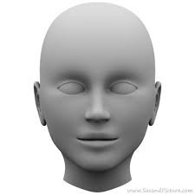
head

Slide 3
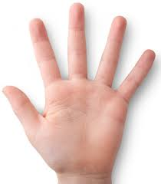
hand

Slide 4
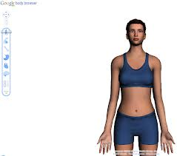
BODY

